Slide 1
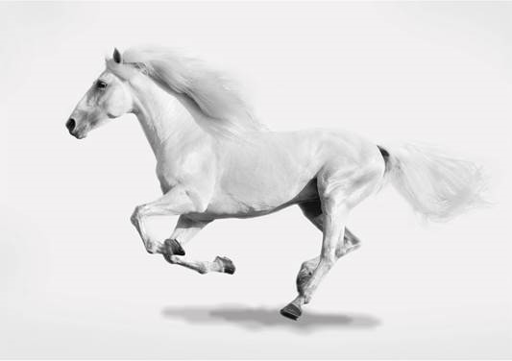
Powerful
Disciplined
Itinerant
Directed
Strong
Meek
Flexible
Faithful
Reproducing
Obedient
The Kingdom advancing,
‘Go and make disciples...
teaching them to obey’.
EYES, EARS & MOUTH
OF THE PROPHETIC
WATCHMEN
WORSHIP
PROCLAMATION
PRAYER
LOVE IN ACTION
The Ultimate Servant
Notes:
1
With just the blank picture of the horse showing ask group members to name some characteristics or aspects of a horse’s nature.
Once you have all their suggestions. Click the mouse until all 10 characteristics appear at the top of the screen.
The horse is a prophetic picture of a new wineskin for the Kingdom of God. Ask the group is they can guess what the pats of the horse’s body might speak of?
Beginnings with the head allow the various body parts to appear on the screen explaining as follows:
Head: this represents the eyes, ears and mouth of the prophetic. The head goes in front of the rest of the body. God’s Word says that He does not do anything without first telling His prophets..
Front legs: the first leg is worship; the second is prayer. Worship is the door through which we position ourselves before Father God’s throne in a place where our prayers are then heard and answered. The front legs dig up the ground and provide a spring-board for where the back legs can safely land. Everything we do in God’s Kingdom must be preceded by ground-breaking worship & prayer – personally and corporately.
Back legs: The proclamation of the message of Father’s love and the presence of the Kingdom of God. For the message to truly be authentic it must be followed by the tangible signs and wonders of Father God’s in-breaking reality to save, heal, release and restore. The horse’s back legs always land in the exact spot where the front legs have previously been which demonstrates the validity of my point about worship above.
Tail: Wherever God’s Kingdom is breaking out our enemy Satan will use his ‘flies’ (demonic forces) to try to bring infection or kill. The horse’s tail is there to swish the flies away. Spiritually this is done through the ministry of the intercessory ‘watchmen’. The tail is also there to protect the vulnerable parts of the body which again speaks of protective prayer for those who are weak, helpless, at risk or in danger.
Body: This ‘horse of the Lord’ cannot be built by the hand of man; it must be created by the Spirit of God because it is a living, breathing entity. Its total purpose, as it moves from place to place, is to carry the presence and glory of the King of kings accompanied by visible signs of the in-breaking reality of His Kingdom.
5. The horse is a perfect picture of the ultimate servant of God’s Kingdom. God’s power under the control of the one who steers & holds the reins i.e. a new way of being ‘church’, a way that teaches, equips & then releases the Body to carry the presence of Jesus wherever He may lead. It ‘church’ without walls.

