Slide 1
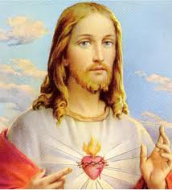
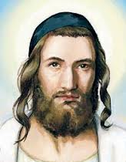
Who is the real Jesus?
White Roman catholic or protestant?
Jewish rabbi?

